Slide 1

BITCOIN AND MAJOR ALTCOINS/MEMECOINS CORRELATION “PRICE PREDICTION AND AUTOMATED TRADING STRATEGY ALGORITHM.
By Sebastião Ngombo

Slide 2
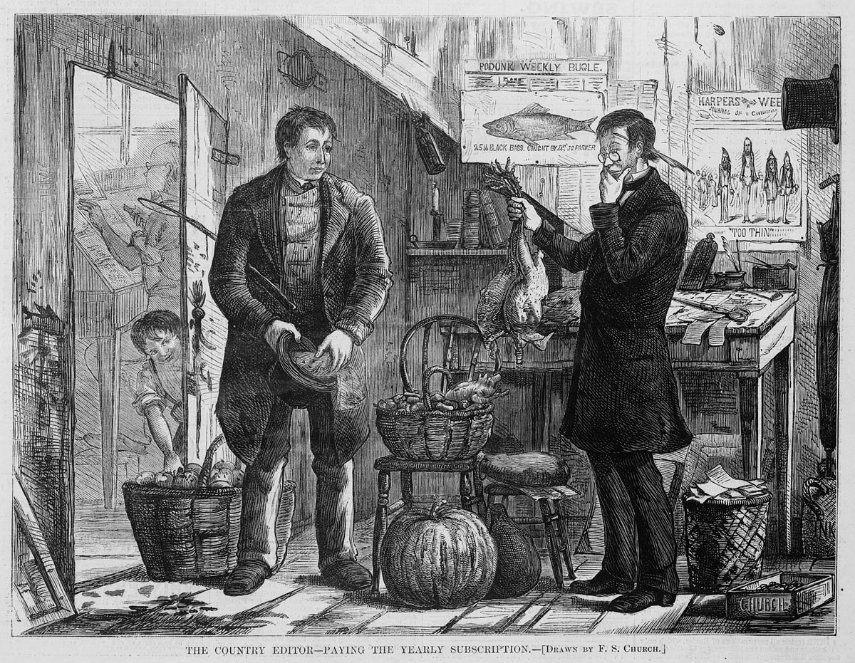




HISTORY OF TRADE
Emergence of Money and Cities (3000 B.C. - 1400 A.D.)
Globalization and Modern Trade (1900-2000)
Primitive Trade (Before 3000 B.C.)
Age of Exploration (1400-1700)
Industrial Revolution (1700-1900)
Barter System: Early societies engaged in direct exchange of goods and services without money.
Common Goods: Food, tools, livestock, and handmade items
Invention of Money (600 B.C.): The introduction of metal coins (gold, silver, copper) made trade more efficient.
Famous Trade Routes: Silk Road (China-Europe), spice trade routes.
Common Goods: Spices, silk, salt, gold, and silver.
Maritime Exploration: Europeans explored new trade routes to the Americas, Asia, and Africa.
Triangular Trade: Included the exchange of slaves, sugar, tobacco, cotton, and manufactured goods.
Common Goods: Spices, gold, silver, slaves, and agricultural products.
Maritime Exploration: Europeans explored new trade routes to the Americas, Asia, and Africa.
Triangular Trade: Included the exchange of slaves, sugar, tobacco, cotton, and manufactured goods.
Common Goods: Spices, gold, silver, slaves, and agricultural products.
Post-World War II: Global trade expanded through economic blocs and multilateral agreements.
Technology and E-commerce: The internet and e-commerce revolutionized the trade of goods and services.
Common Goods: Oil, automobiles, electronics, agricultural commodities.

Slide 3


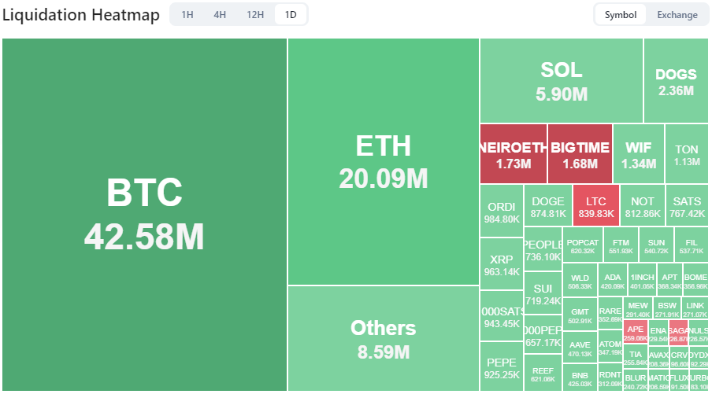





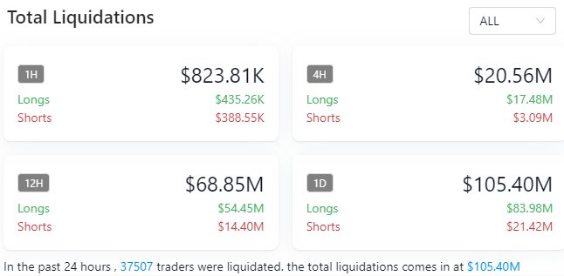
THE AGE OF CRYPTOCURRENCIES (2009 - PRESENT)
$2.06 Trillion
+ 25,0K
+100 Bilions
The global cryptocurrency market cap today
Crypto coins Publicy listed
Daily transaction volume
1.110
285
118
73
60
BTC
ETH
USDT
BNB
SOL

Slide 4

BUSINESS OPPORTUNITIES & HYPOTESIS
Business problems and opportunities
Unpredictable price movements lead to difficulty in timing market entry and exit.
Overexposure to highly correlated cryptocurrencies leads to poor diversification.
Simple price predictions often generate false buy/sell signals.
Trading without stop-loss and take-profit levels can lead to large drawdowns.
Manual trading decisions are prone to emotional biases and can’t capture 24/7 market opportunities.
Automating the strategy will ensure consistent, objective trading, leading to improved overall performance.
Hypotesis
Machine learning predictions will improve the accuracy of price forecasts, enabling better trade execution..
Trading on weaker correlations can reduce risk and increase portfolio stability.
Combining machine learning predictions with technical indicators will reduce false signals and enhance strategy performance.
Risk management techniques will reduce drawdowns and increase overall portfolio value.

Slide 5



DATA WRANGLING, CLEANING & EDA
Initial Data Collected
Initial Challenge
Refined Approach
Coins: Data was collected for the following cryptocurrencies: BTC, ETH, ADA, DOGE, XRP, LTC, LINK, XLM.
Timeframes: Data was initially gathered from 2018 to 31st August 2024, across the following time intervals: 1 min, 5 min, 15 min, 30 min, 1 hour, 4 hours, 8 hours, and 1 day.
Purpose: This variety of timeframes was intended to capture both short-term price movements and long-term trends for training the models.
The amount of data collected for the initial time range (2018-2024) and granularity (1-minute, 5-minute, etc.) resulted in large datasets that required extensive computational resources and time to train the machine learning models.
Adjusted Data Collection:Cutoff Period: To improve model training efficiency, the date range was adjusted to 2022 to 31st August 2024.
Chosen Interval: The 4-hour interval was selected to balance the need for data granularity with computational efficiency.
Final Dataset Size: The final dataset size for each coin resulted in 5,831 rows and 20 columns (including technical indicators, lagged features, and other predictors).

Slide 6
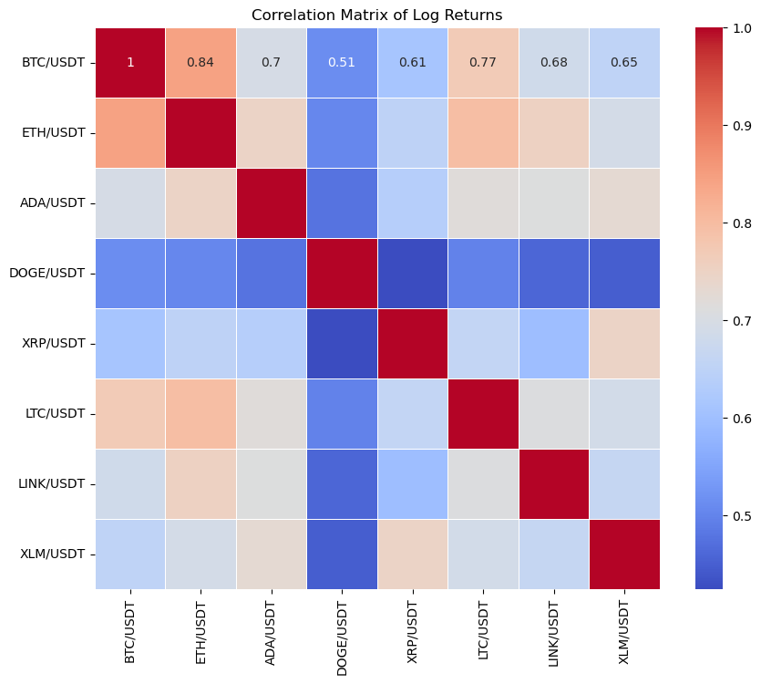
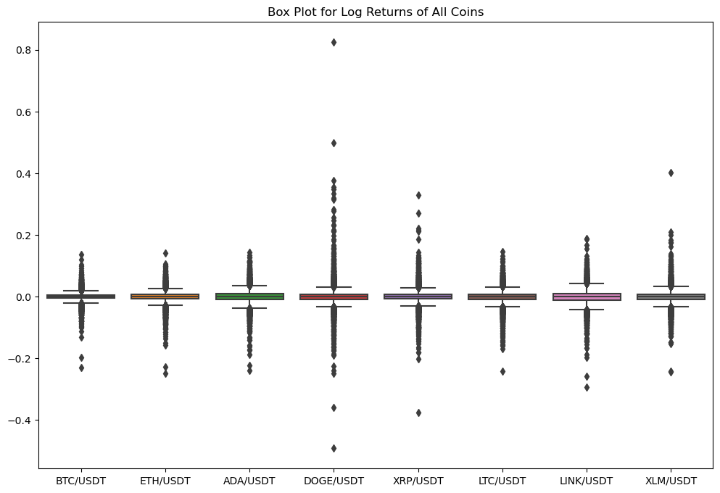
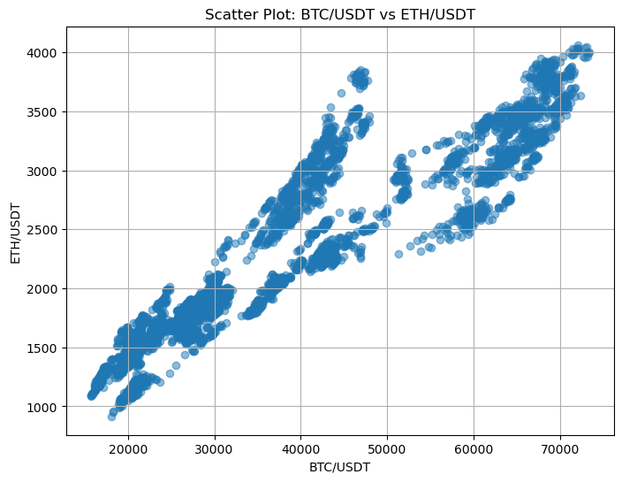
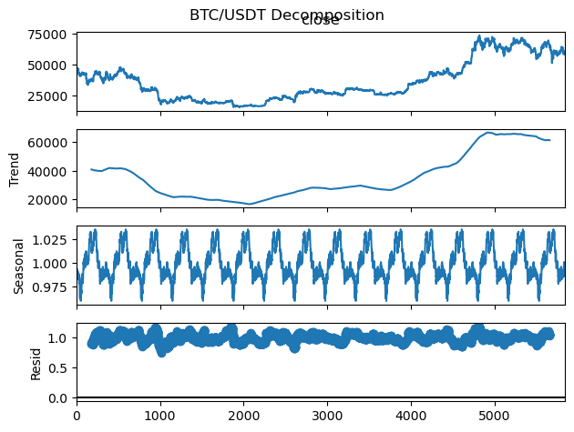




DATA WRANGLING, CLEANING & EDA
Missing Values Handling;
Outlier Detection and Removal
Feature Scaling;
Lag Features for Time Series Prediction
Train-Test Split (Avoiding Data Leakage)
Correlation Matrix
Timestamp definition
Addressing Non-Stationarity (Time Series Analysis)
Signal Generation
Data Quality and Consistency
The refined data size allowed for faster model training without sacrificing predictive accuracy.
The 4-hour timeframe still provided sufficient granularity to capture important price movements while reducing the overall computational load.
API Rate Limits and Access Restrictions
Data Integration and Compatibility
Articulate features for prediction based on a prediction

Slide 7

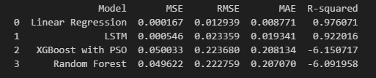
MACHINE LEARNING MODELS APPLIED,
In this project, we applied three key machine learning models—Linear Regression, Random Forest, and LSTM—to the problem of cryptocurrency price prediction and trading strategy development. Each model was carefully selected based on its suitability for the data and business problem. Additionally, hyperparameter tuning was proficiently used to optimize the performance of these models, ensuring that they could effectively capture patterns in the data and generate actionable trading signals.
Linear Regression Model
(Linearity, Stationarity “The Dickey-Fuller test”, Multicollinearity & Hyperparameter Tuning).
Random Forest Regressor
(No strict assumptions, No Scaling Needed & Hyperparameter Tuning).
Long Short-Term Memory (LSTM) Model
(Temporal Dependency, Stationarity, Scaling & Hyperparameter Tuning)
XGBoost with Particle Swarm Optimization (PSO)
Notes:
Linear Regression Model
Why It's Applied:
Suitability for Data: Linear regression is a simple and interpretable model that fits well with time series data when the relationships between features and the target variable are mostly linear.
Assumptions Checked: We ensured that:
Linearity: The relationship between the lagged features (lagged closing prices) and the target variable (future prices) was assumed to be linear.
Stationarity: We addressed the issue of non-stationarity in the time series by performing differencing and stationarity checks (e.g., the Dickey-Fuller test) to stabilize the time series data.
Multicollinearity: Using lagged prices may introduce multicollinearity. While not a strict requirement for linear regression, reducing multicollinearity can improve the model’s interpretability. A correlation matrix was used to understand feature relationships.

Slide 8

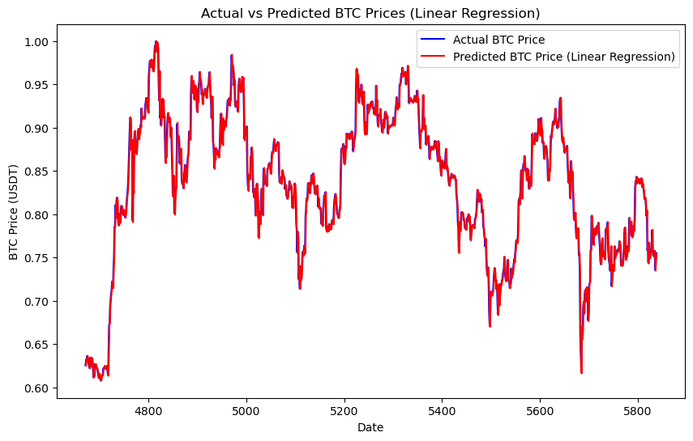
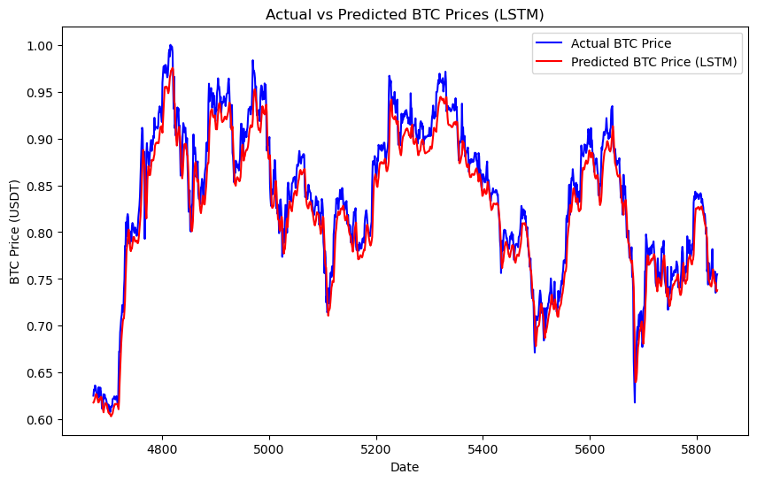
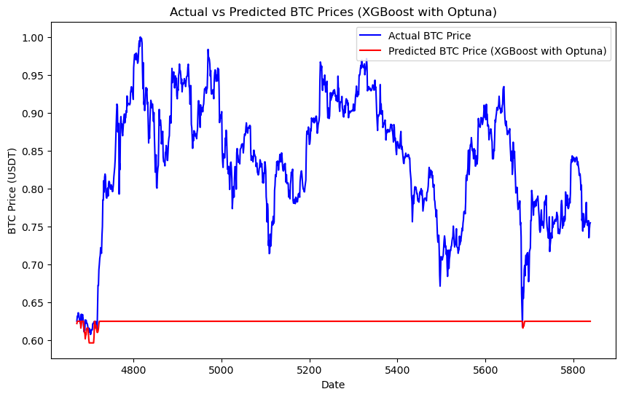
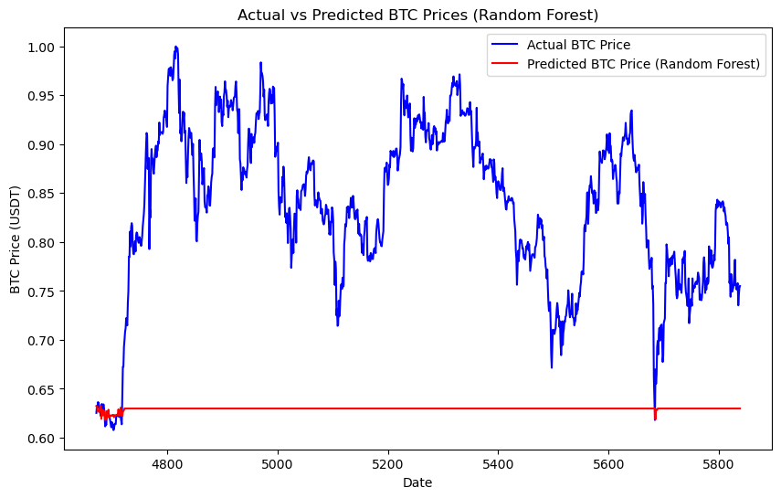
MACHINE LEARNING MODELS APPLIED,

Slide 9
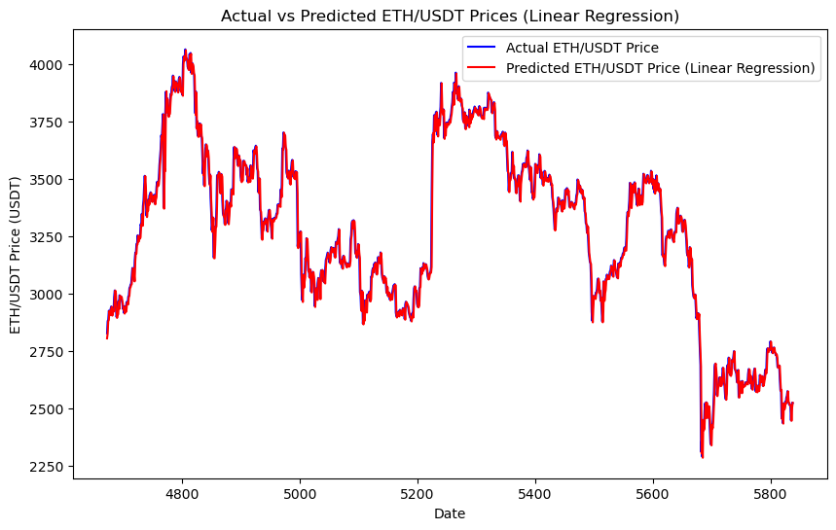
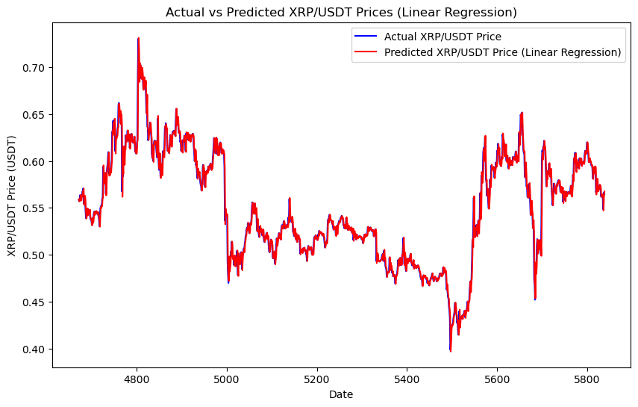
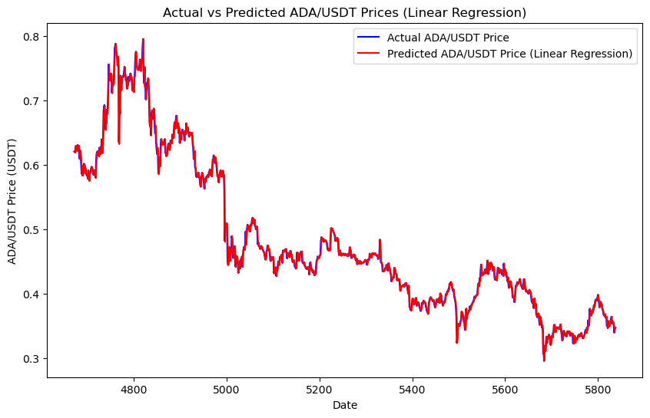
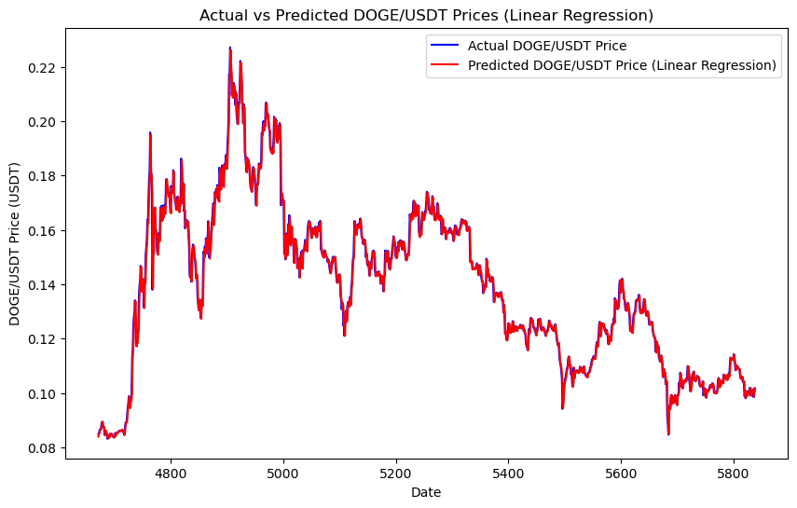
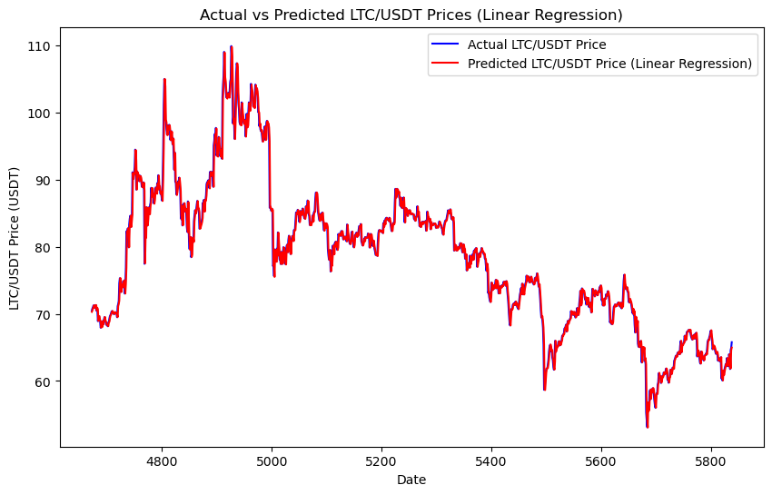
PREDICTED PRICES
Predited Crypo Coins Price Sample

Slide 10
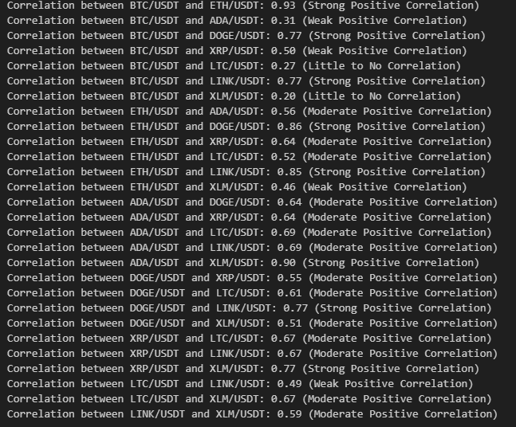
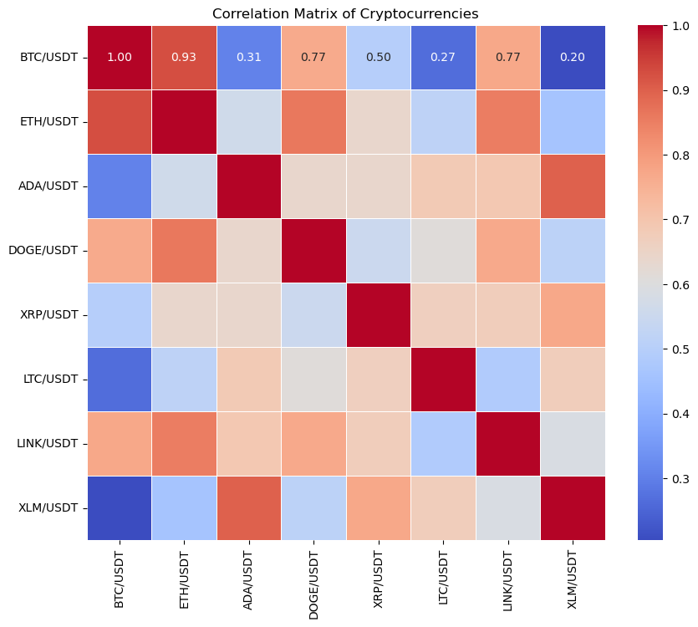
PREDICTED PRICES

Slide 11
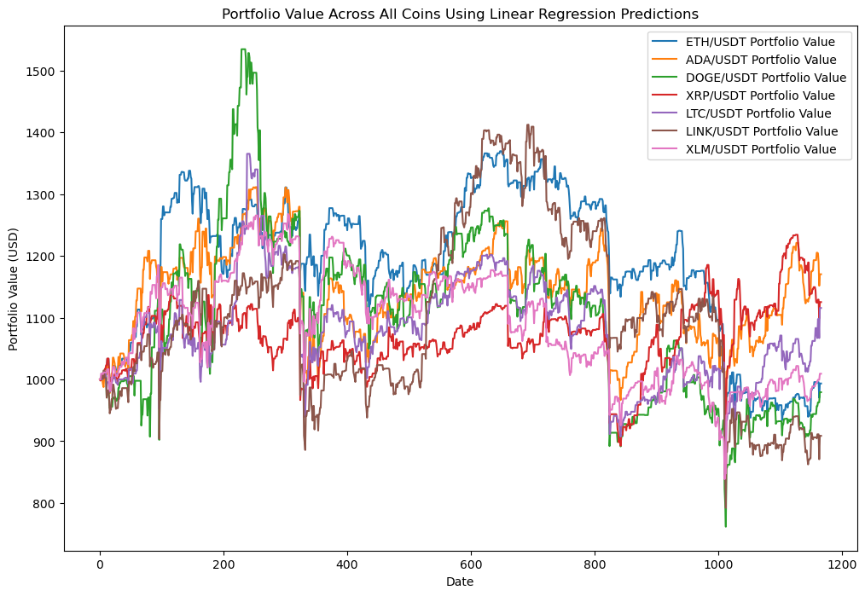
TRADING STRATEGY DESIGN & BACKTESTING
ETH/USDT Prediction (No BTC) - RMSE: 46.00389756067349, MAE: 30.250143302410095, R-squared: 0.9854394523200481Final portfolio value for ETH/USDT: $993.39 Total Return: -0.66% Number of Trades: 1167
ADA/USDT Prediction (No BTC) - RMSE: 0.009606725983774001, MAE: 0.005774532434227402, R-squared: 0.9933117488654116Final portfolio value for ADA/USDT: $1170.29 Total Return: 17.03% Number of Trades: 1167
DOGE/USDT Prediction (No BTC) - RMSE: 0.003552613099891613, MAE: 0.002248832550880753, R-squared: 0.9859153720413065Final portfolio value for DOGE/USDT: $979.26 Total Return: -2.07% Number of Trades: 1167
XRP/USDT Prediction (No BTC) - RMSE: 0.009168417103398243, MAE: 0.005764027233645064, R-squared: 0.9745009514855135Final portfolio value for XRP/USDT: $1125.21 Total Return: 12.52% Number of Trades: 1167
LTC/USDT Prediction (No BTC) - RMSE: 1.3109443334627862, MAE: 0.8055934126163901, R-squared: 0.9857548148350573Final portfolio value for LTC/USDT: $1115.66 Total Return: 11.57% Number of Trades: 1167
LINK/USDT Prediction (No BTC) - RMSE: 0.28948990728760693, MAE: 0.1872543887332364, R-squared: 0.9905939979023619Final portfolio value for LINK/USDT: $908.66 Total Return: -9.13% Number of Trades: 1167
XLM/USDT Prediction (No BTC) - RMSE: 0.0017929810023674597, MAE: 0.001104066349996723, R-squared: 0.9874165870496845Final portfolio value for XLM/USDT: $1009.21 Total Return: 0.92% Number of Trades: 1167

Slide 12

CONCLUSIONS & BUSINESS IMPLICATIONS
Models successfully predicted price trends, especially for coins with moderate correlations to BTC.
The strategy yielded positive ROI across most coins, with optimal performance for weakly correlated assets (e.g., ADA, XRP).
Effective risk management led to more consistent portfolio performance, limiting losses in volatile markets.
Automated trading based on predictive models allows for round-the-clock execution and removes emotional bias from decision-making.
Leveraging correlation analysis helps identify under-diversified portfolios and enables more strategic asset selection.
The model-driven trading strategy is scalable across multiple cryptocurrencies, making it a valuable tool for portfolio managers and traders.
Notes:
top-loss and take-profit mechanisms stabilize returns and reduce drawdowns.Conclusion: Effective risk management led to more consistent portfolio performance, limiting losses in volatile markets.

Slide 13


BITCOIN AND MAJOR ALTCOINS/MEMECOINS CORRELATION “PRICE PREDICTION AND AUTOMATED TRADING STRATEGY ALGORITHM.
"In God we trust, all others must bring data."
— W. Edwards Deming
BY
Sebastião Ngombo

